Slide 1
Modeling and simulation of flip flop circuit
Emanuel Cruvinel

Slide 2
Overview
We are going to model and simulate a flip flop circuit using Simulink®

Slide 3
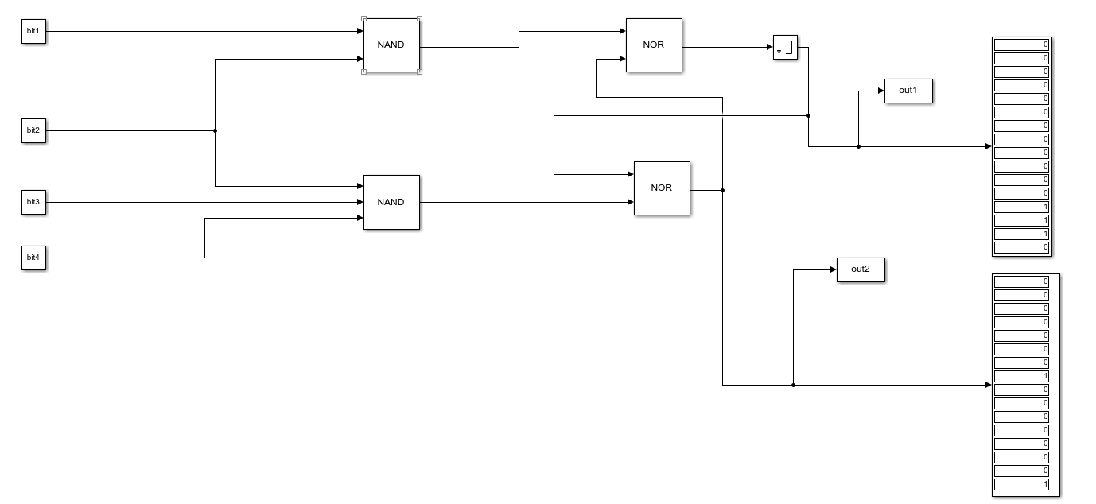
Simulink Model
Output
Flip flop circuit
Input

Slide 4
Analytic equation
Out1 = ((Bit1 * Bit2)’) + Out2)’
Out2 = ((Bit2 * Bit3 * Bit4)’ + Out1)’

Slide 5
Input and output (results)
Input
Bit1 = [ 0 0 0 0 0 0 0 0 1 1 1 1 1 1 1 1 ]
Bit2 = [ 0 0 0 0 1 1 1 1 0 0 0 0 1 1 1 1 ]
Bit3 = [ 0 0 1 1 0 0 1 1 0 0 1 1 0 0 1 1 ]
Bit4 = [ 0 1 0 1 0 1 0 1 0 1 0 1 0 1 0 1 ]
Out1= [ 0 0 0 0 0 0 0 0 0 0 0 0 1 1 1 0 ]
Out2= [0 0 0 0 0 0 0 1 0 0 0 0 0 0 0 1 ]
All bit combinations were tested in the model
The outputs satisfy the analytic equation
Output

Slide 6
Conclusion
The model does satisfy the analytical equation
The flip flop circuit was succesfully modeled with Simulink®

